Slide 1
Threat Probe
To identify vulnerabilities, assess the effectiveness of security controls, and Generate Report on how an attacker might exploit weaknesses

Slide 2
Contents :
What is Threat Probe
Work Flow in brief
Overview of Workflow
Output

Slide 3
What is Threat Probe
Threat Probe is a DevSecOps pipeline that provide’s complete security of the web application. This process automates the testing for security vulnerabilities under categories like Secret Scanning, Software Composition Analysis (SCA), SAST, DAST and issue reporting on – Defect Dojo.

Slide 4

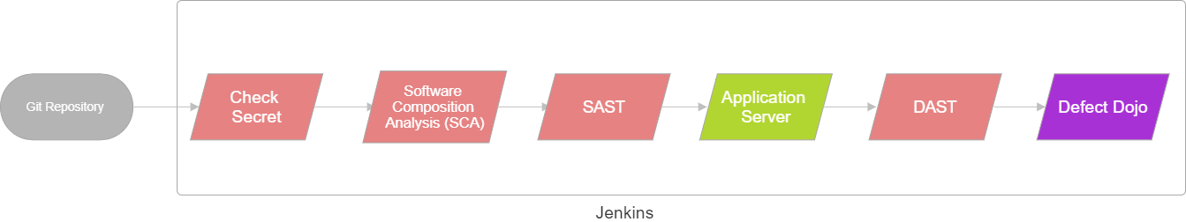
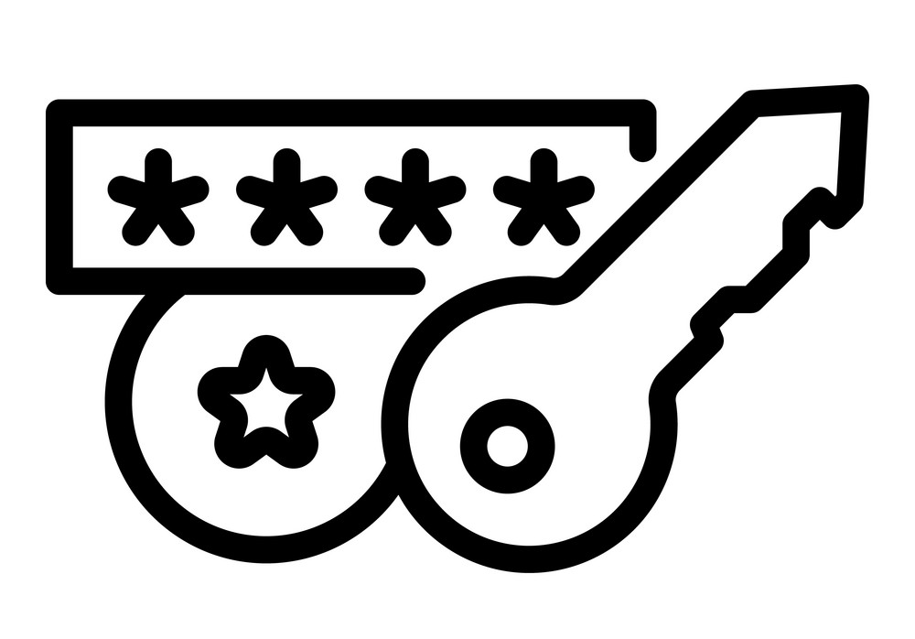



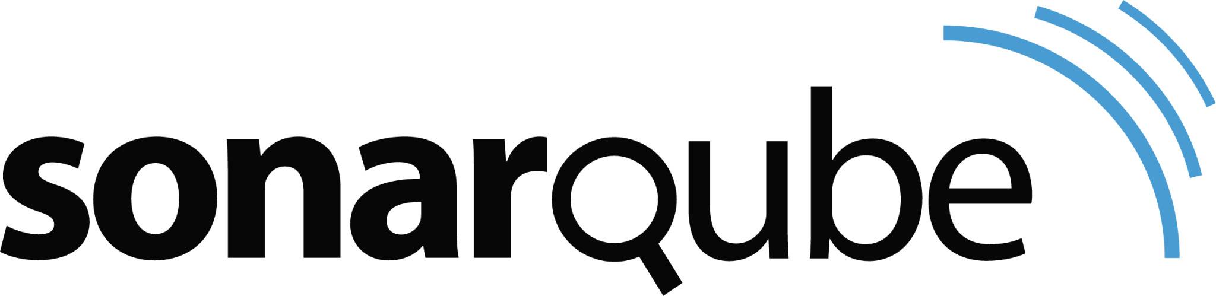

Workflow

Slide 5
Workflow in brief
5 Instances created are : Jenkins, SAST, DAST, Application Server, Defect Dojo.
Jenkins helps developers work faster and more efficiently by automating repetitive tasks involved in building, testing, and deploying software.
In Jenkins we have added plugins like Git, Maven , Sonarqube, dependency checker, docker, Zap Proxy (Owasp Zap) and tools like trufflehog etc
SAST helps developers identify and fix security vulnerabilities in their code before the software is even run, making it a crucial part of secure software development practices.

Slide 6
Workflow in brief
DAST helps identify security issues by testing an application in its running state, focusing on vulnerabilities that appear during execution.
Application Server helps hosting a website. In our project we have used Apache server to host the website
Defect Dojo is designed to simplify the process of handling vulnerabilities discovered during security testing and integrate security findings into a comprehensive security program.

Slide 7
Overview of work flow
Stage Name | Tools used | Findings
Check Secret | TruffleHog | used to detect and manage sensitive information, such as passwords, API keys, tokens, or other secrets, that may accidentally be exposed in source code, configuration files, or logs.
Software Composition Analysis (SCA) | Dependency Checker | essential for managing the risks associated with using open-source and third-party components in software development.

Slide 8
Overview of work flow
Stage Name | Tools Used | Findings
SAST (Static Application Security Testing) | SonarQube | helps ensure that the software is secure, compliant with industry standards, and free of common security flaws before it is even executed. Common vulnerabilities detected by SAST are Sql Injection, Cross-Site Scripting (XSS), Buffer Overflow, Command Injection etc.
DAST (Dynamic Application Security Testing) | OWASP ZAP | helps identify vulnerabilities that may not be visible in the source code, providing an essential layer of security testing for web applications, APIs, and other software systems of an application while it is running. Common vulnerabilities detected by DAST are Cross-Site Scripting (XSS), Sql detection etc.

Slide 9
Use Cases of our project :
Continuous Security Testing
Compliance and Regulatory Requirements
Prevent Secret Leakage
Automated Security Regression Testing

Slide 10
Sc
Screenshots & Outputs

Slide 11
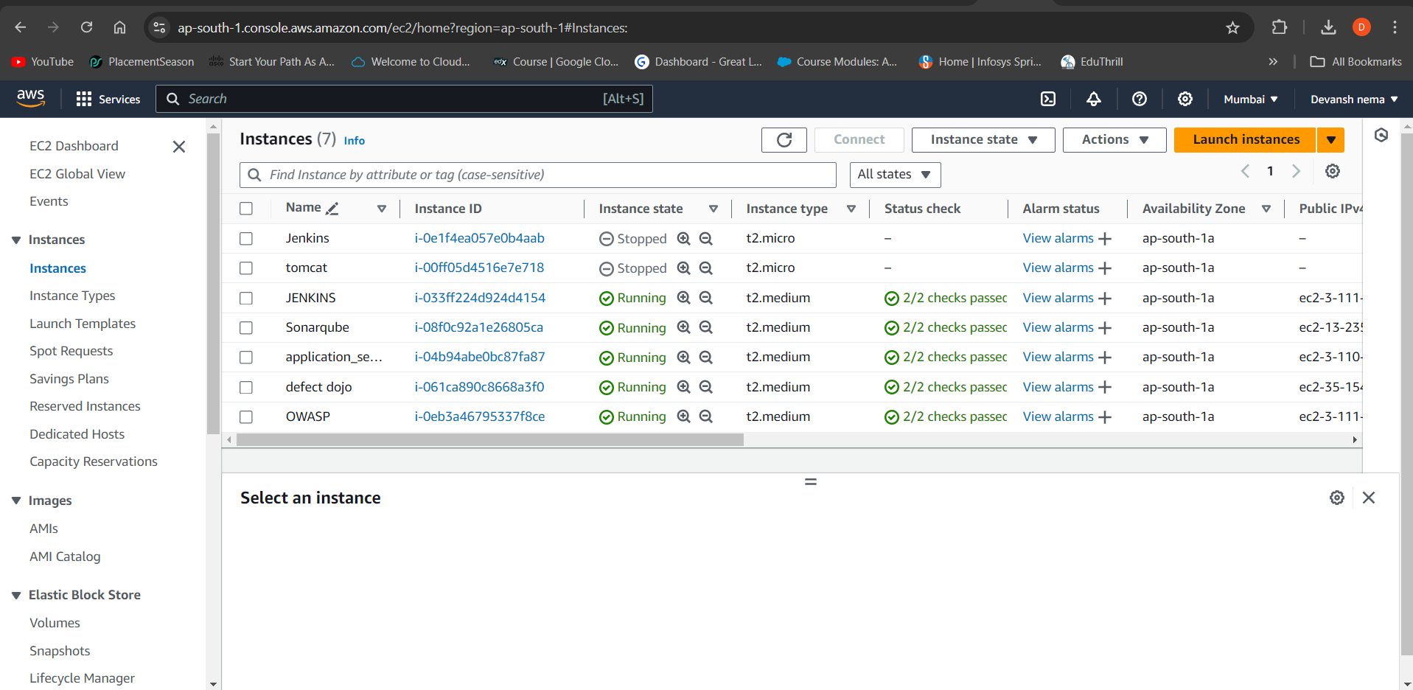

Slide 12
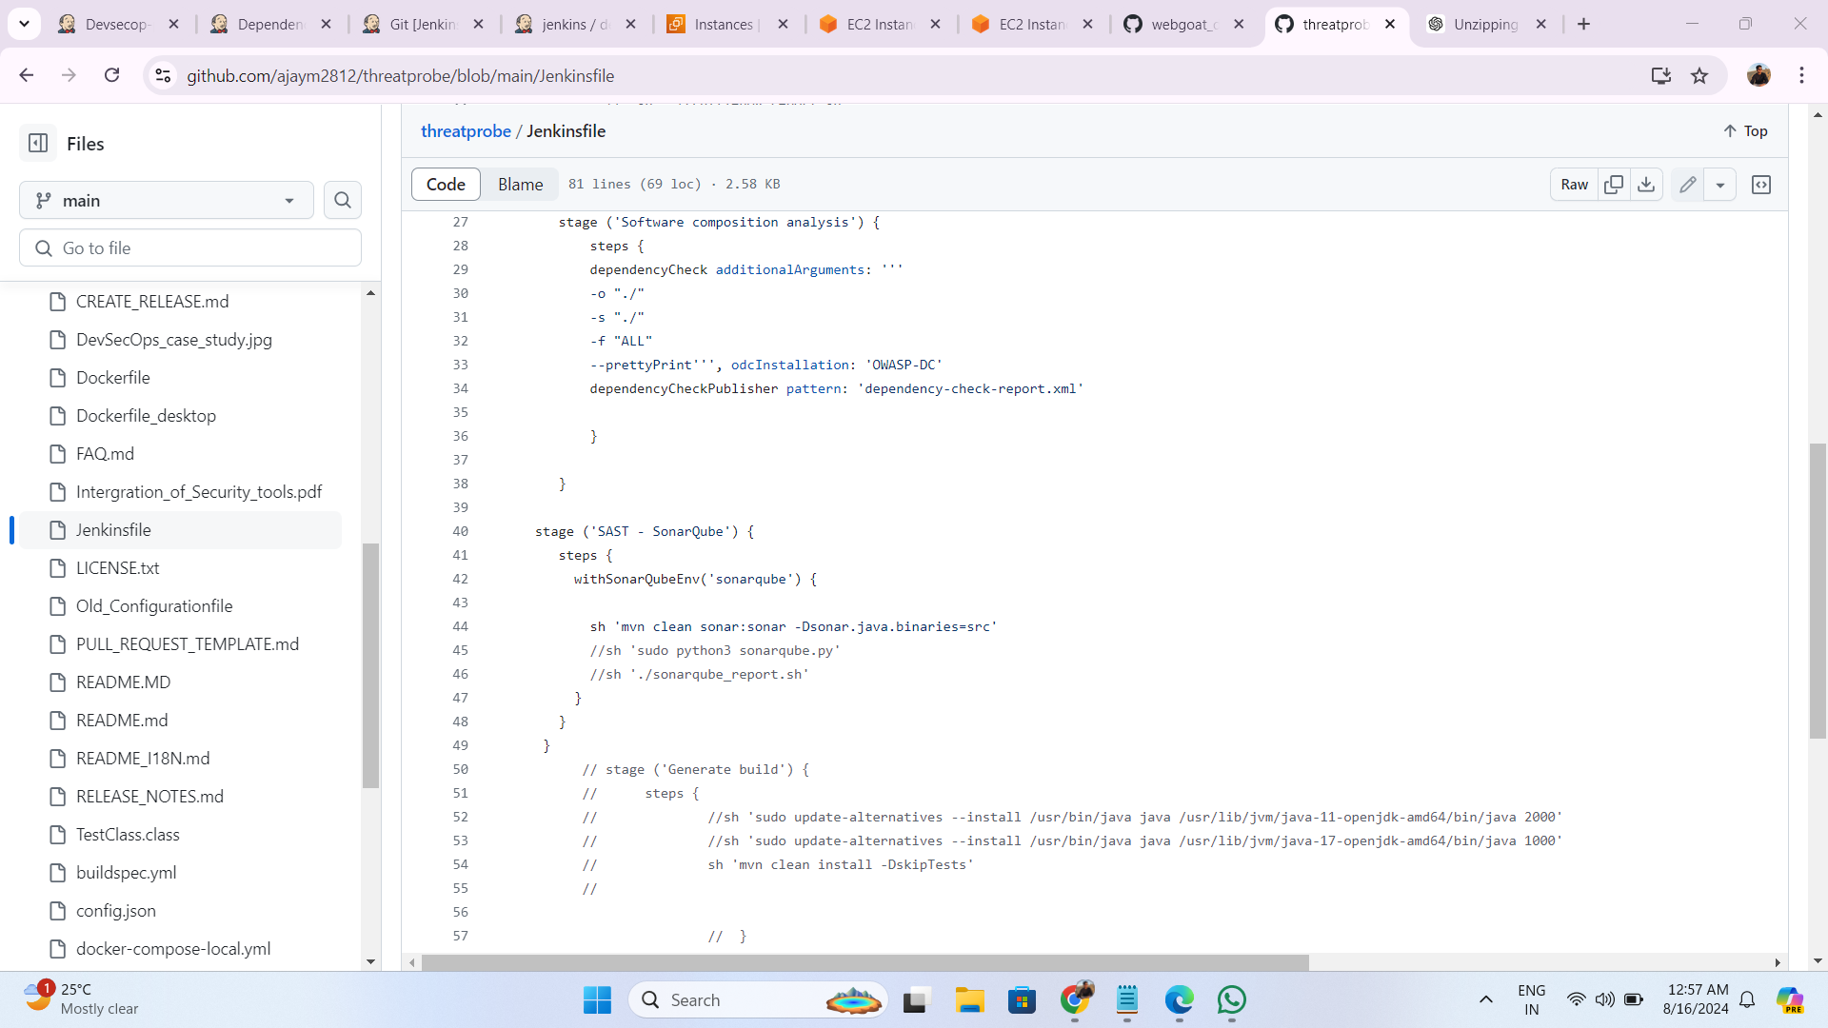

Slide 13
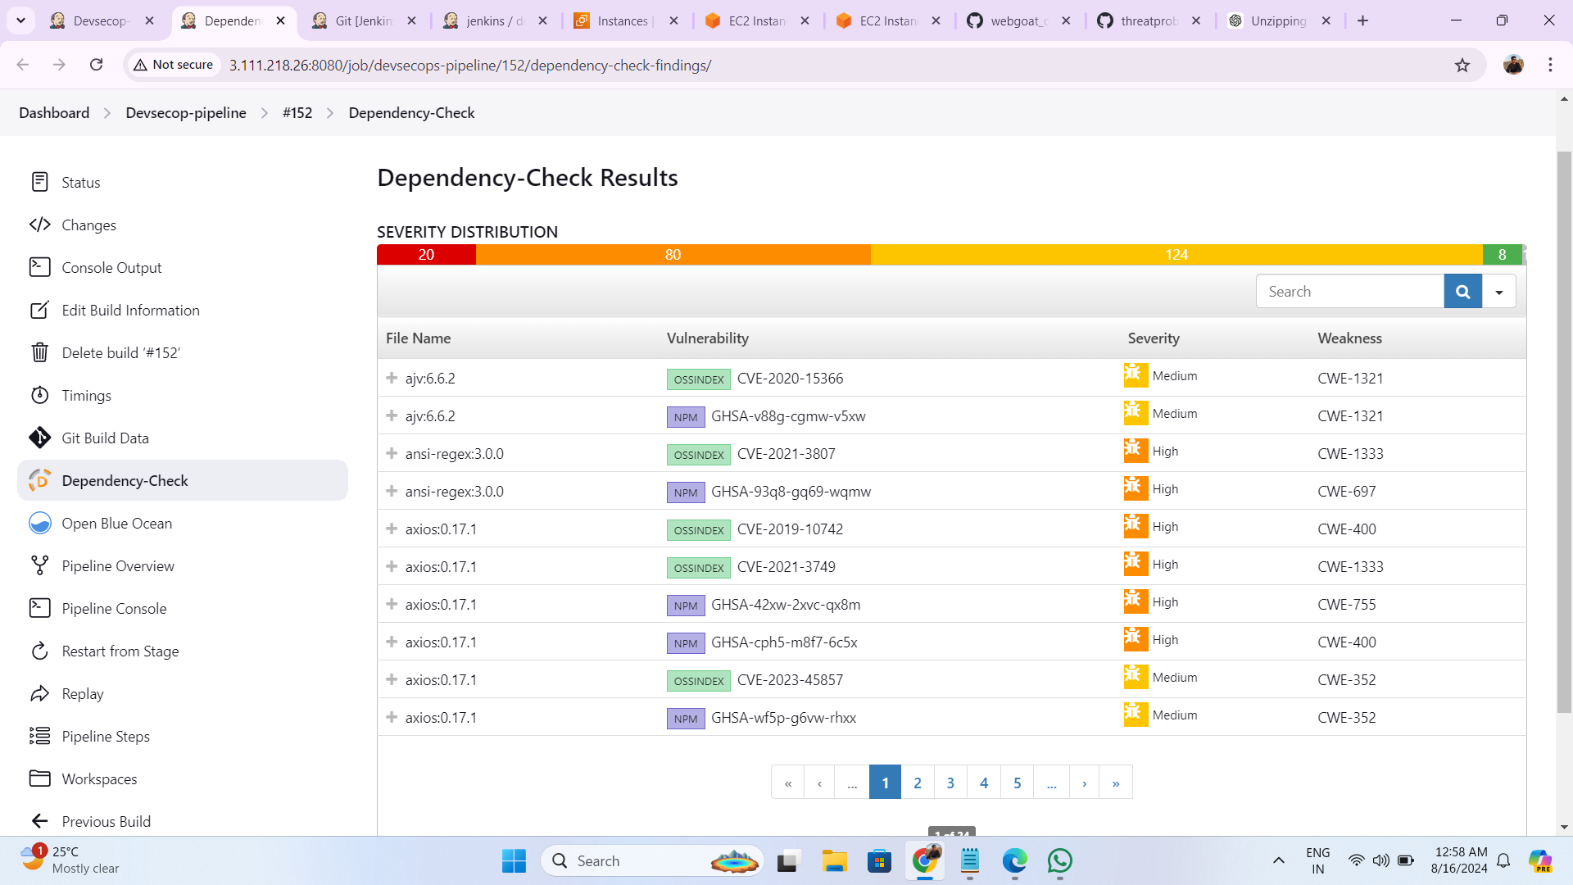

Slide 14
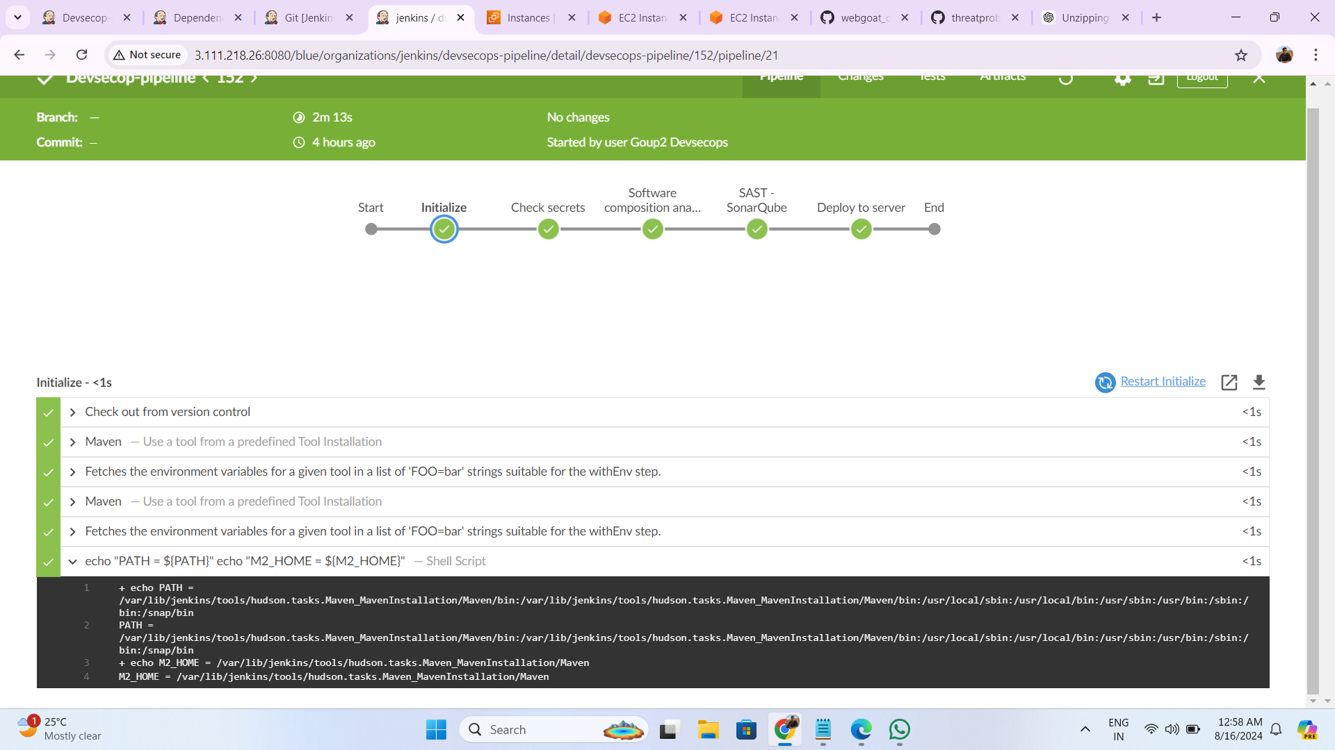

Slide 15
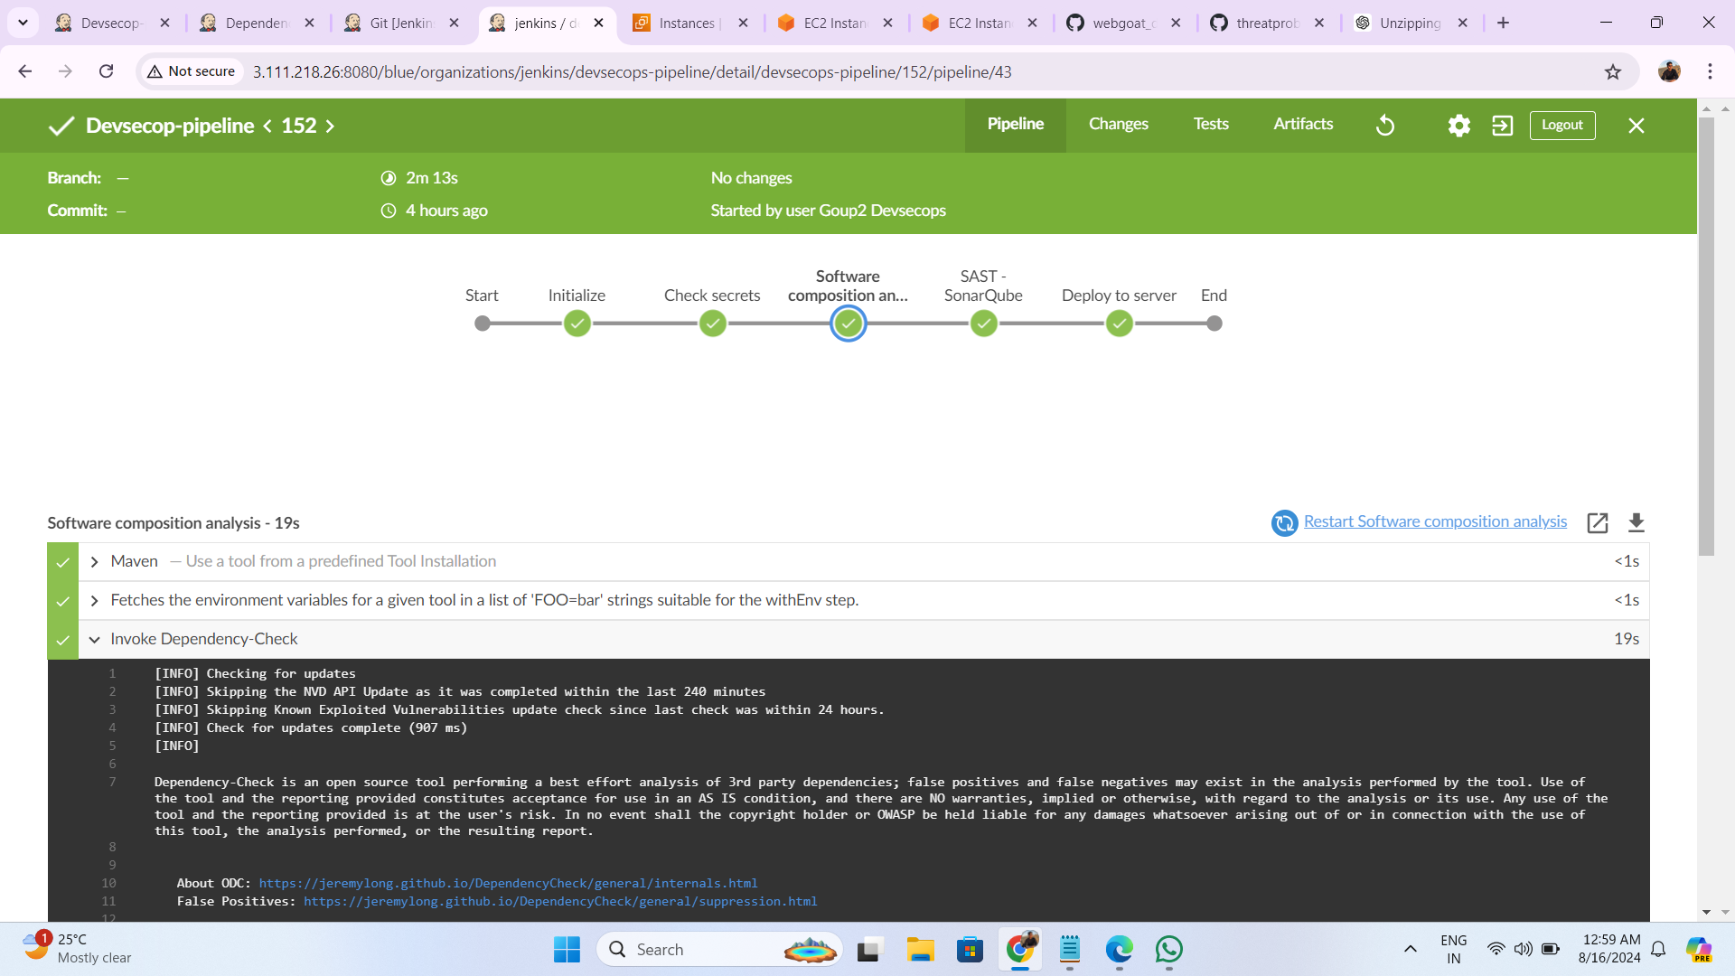

Slide 16
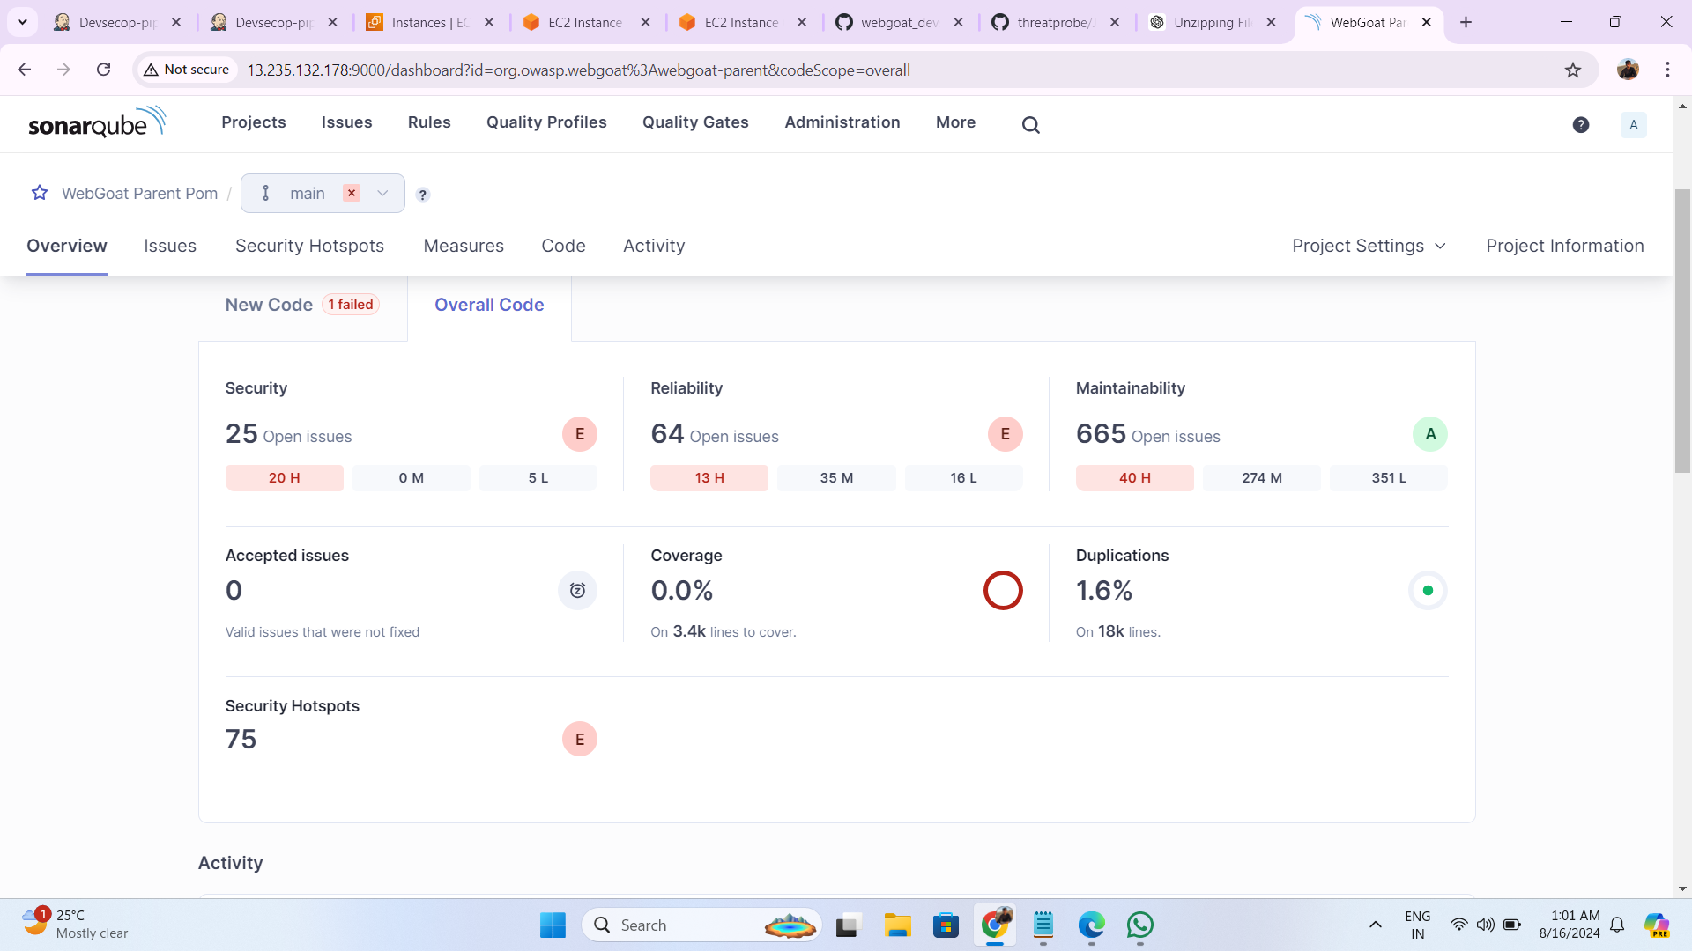

Slide 17
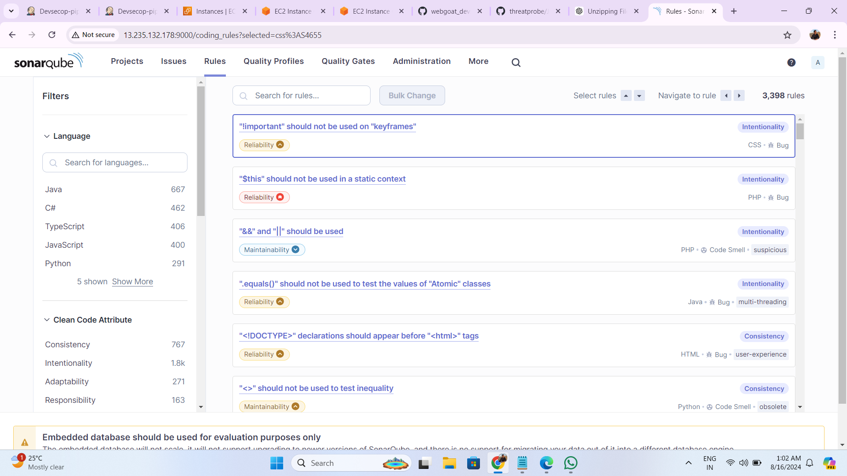

Slide 18
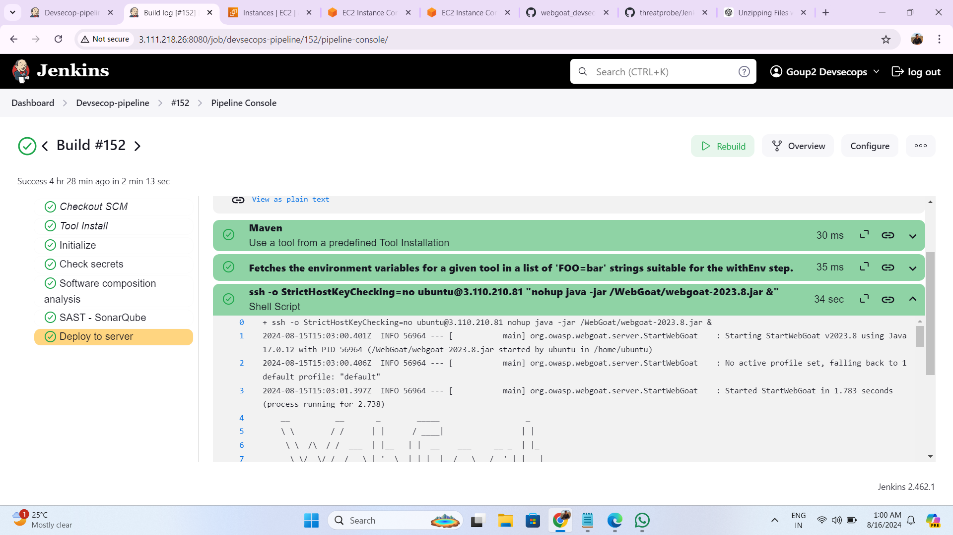

Slide 19
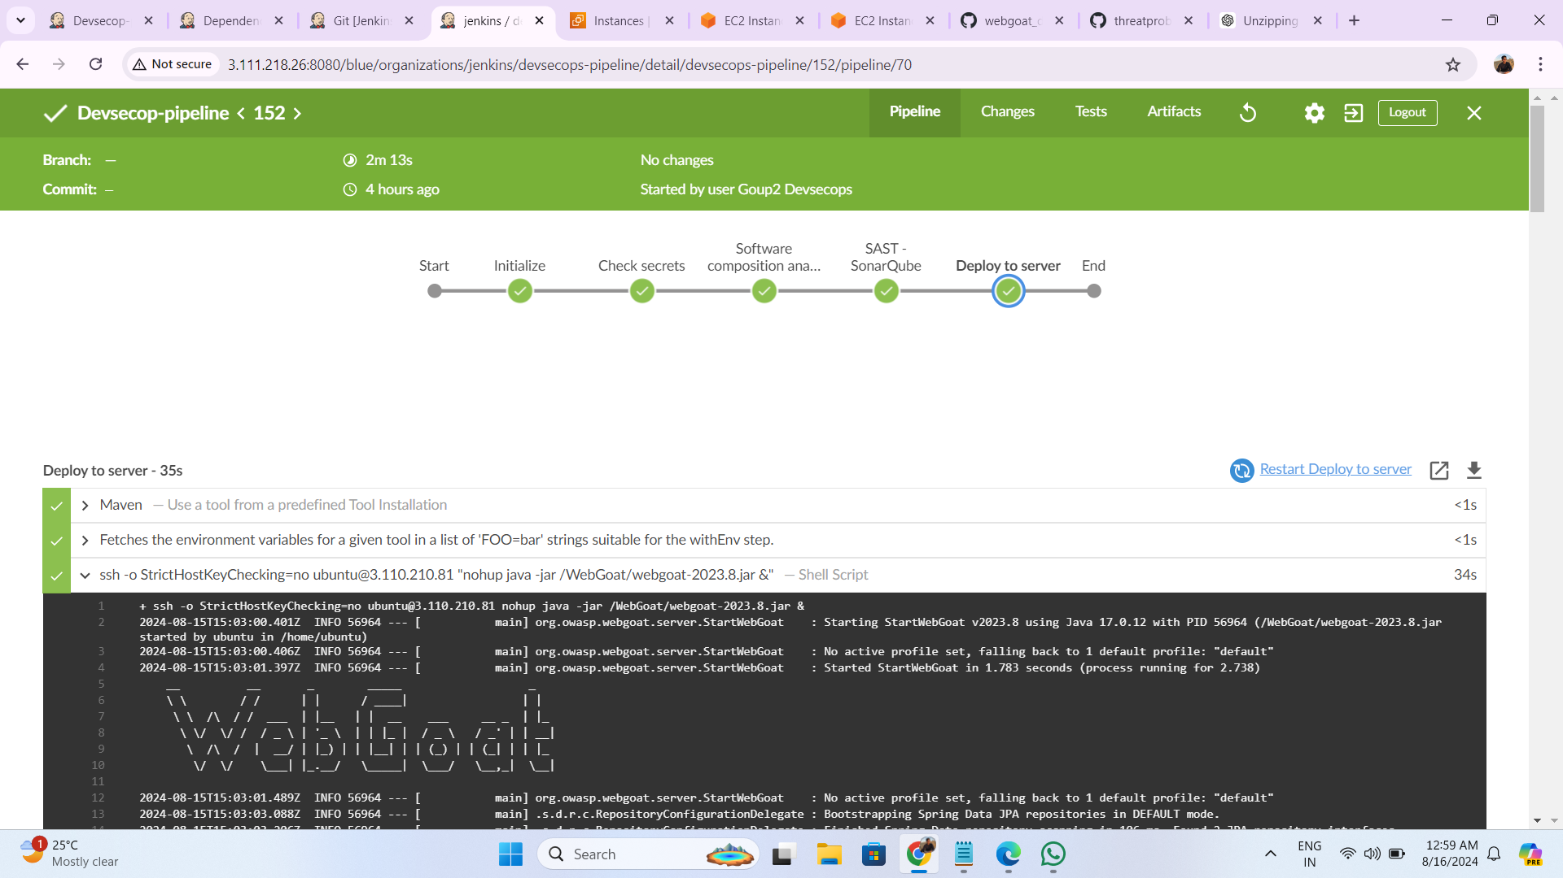

Slide 20
